Slide 1
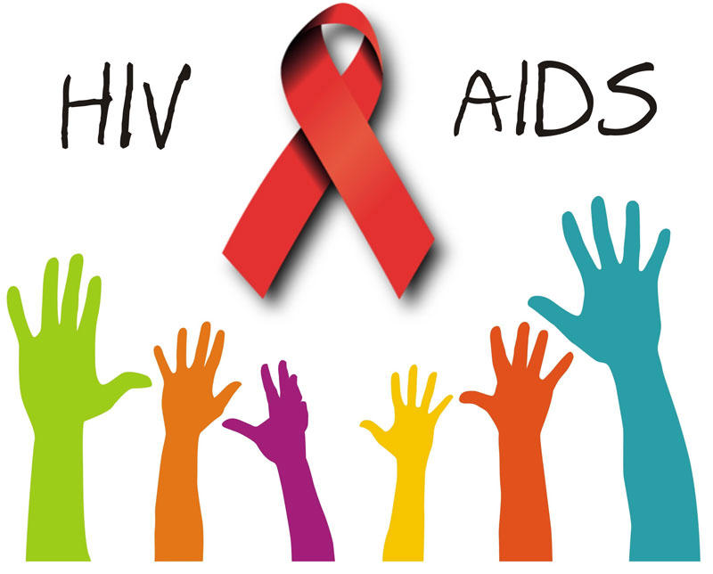

Slide 2
H . I . V .
Human Immuno-deficiency Virus
VIRUS: an infective agent that typically consists of a nucleic acid molecule in a protein coat, is too small to be seen by light microscopy, and is able to multiply only within the living cells of a host.
Transmitted by these bodily fluids:
Breast milk
Blood
Vaginal fluid
Semen
Accurate Test result takes 3 months!
People that are HIV positive can now live longer, healthier, lives when they’re in routine care

Slide 3
T-Cell and HIV
T-cells (or T-lymphocytes) are white blood cells that play an important role in the immune system. There are 2 types of T-cells. 1 type has molecules called CD4 on its surface; these `helper' cells orchestrate the body's response to certain micro-organisms such as viruses. The other T-cells, which have a molecule called CD8, destroy cells that are infected & produce antiviral substances. HIV is able to attach itself to the CD4 molecule, allowing the virus to enter & infect these cells, damaging them. The CD4 count is a reflection of how many functional CD4 t-cells are circulating in the blood.
Normal values: Varies but usually 600 - 1200 in a healthy adult.
Less than 350: The immune system is somewhat weakened.
- Your doctor may consider starting HIV medications and prophylactic antibiotics.
Less than 200: The person is at a much greater risk of opportunistic infections.
- HIV medications and prophylactic antibiotics will be prescribed to help prevent these infections.

Slide 4
A . I . D . S .
Acquired Immuno Deficiency Syndrome
SYNDROME: a group of symptoms that together are characteristics of a specific disorder, disease, or the like.
HIV is the virus that causes AIDS
AIDS is diagnosed when T-cell count is below 200 per cubic ml of blood
Without treatment, people who progress to AIDS typically survive about 3 years. Once you have a dangerous opportunistic illness, life-expectancy without treatment falls to about 1 year.
https://www.youtube.com/watch?v=ng22Ucr33aw

